Slide 1
HTML TAGS OF - H&M WEBSITE

Slide 2
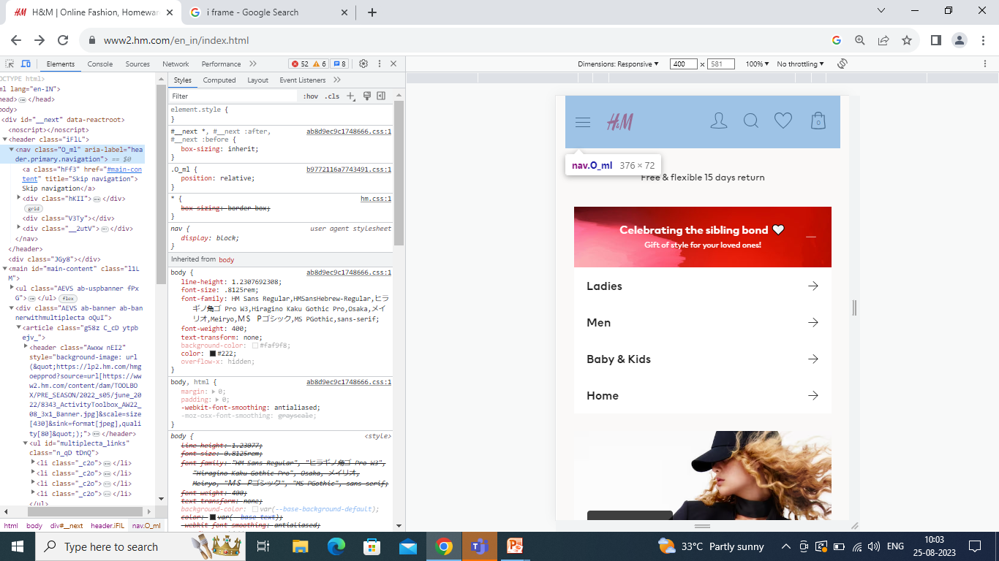
HEADER AND NAV TAG

Slide 3
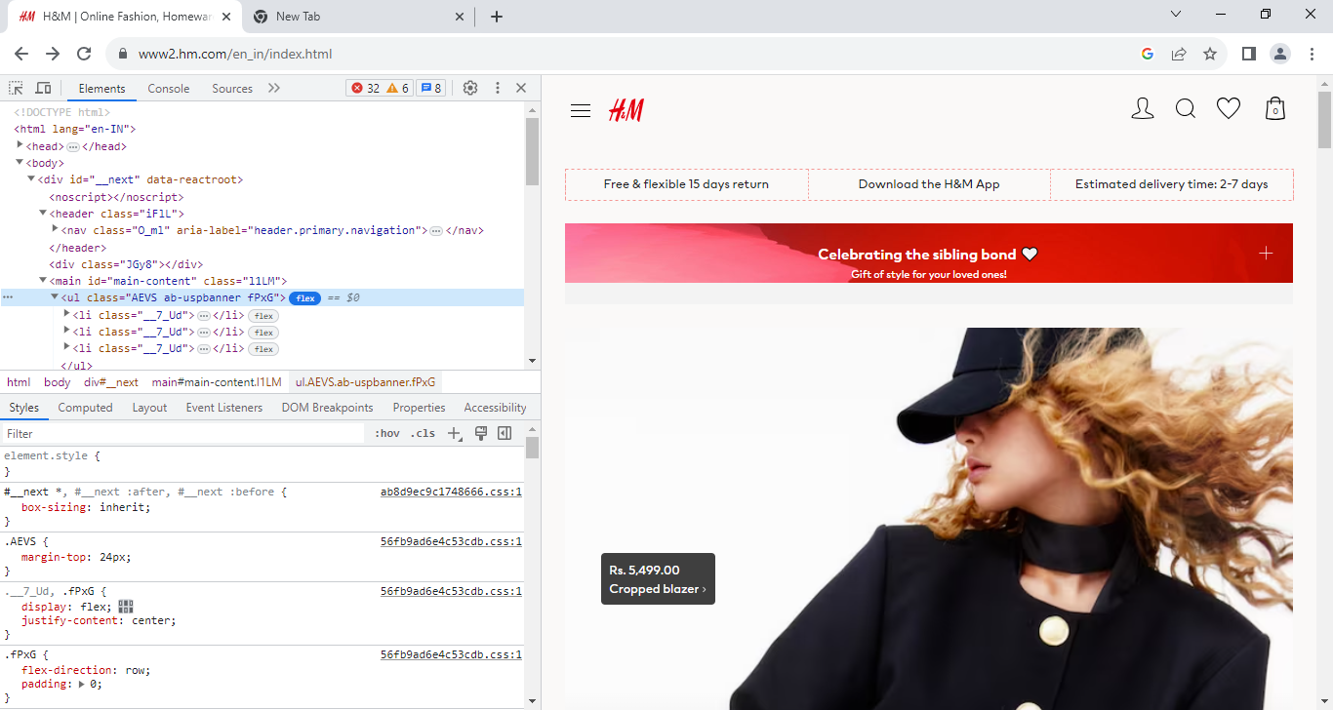
LIST TAG’S

Slide 4
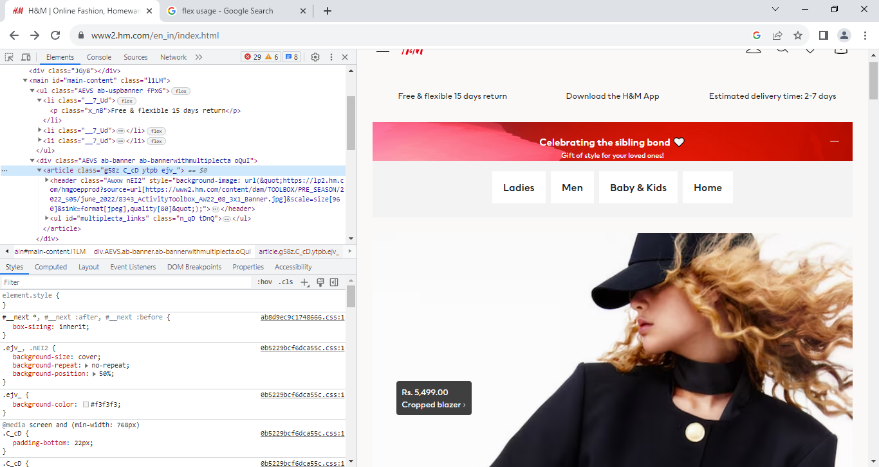
ARTICLE TAG

Slide 5
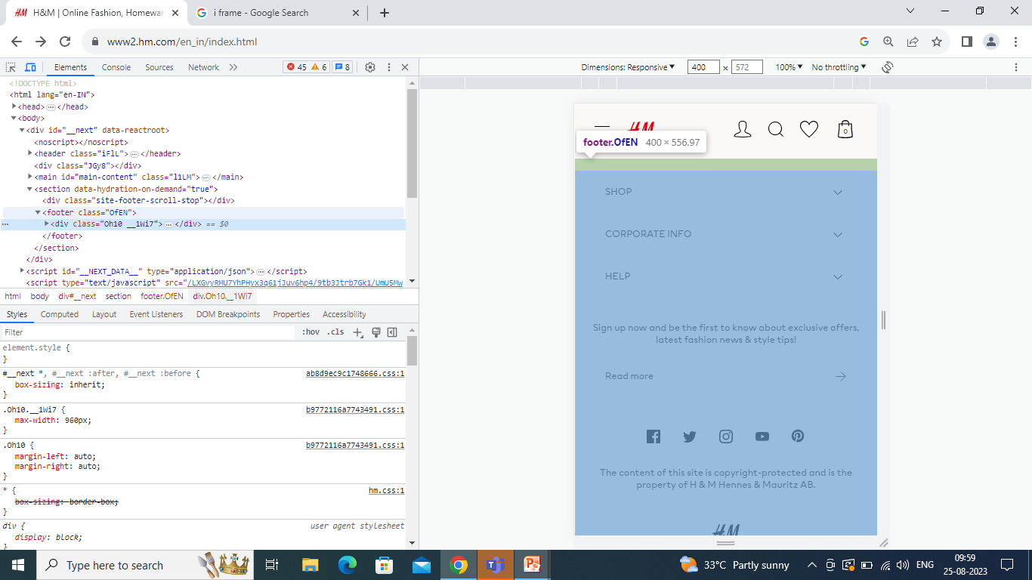
MAIN and IFRAME TAG’S

Slide 6
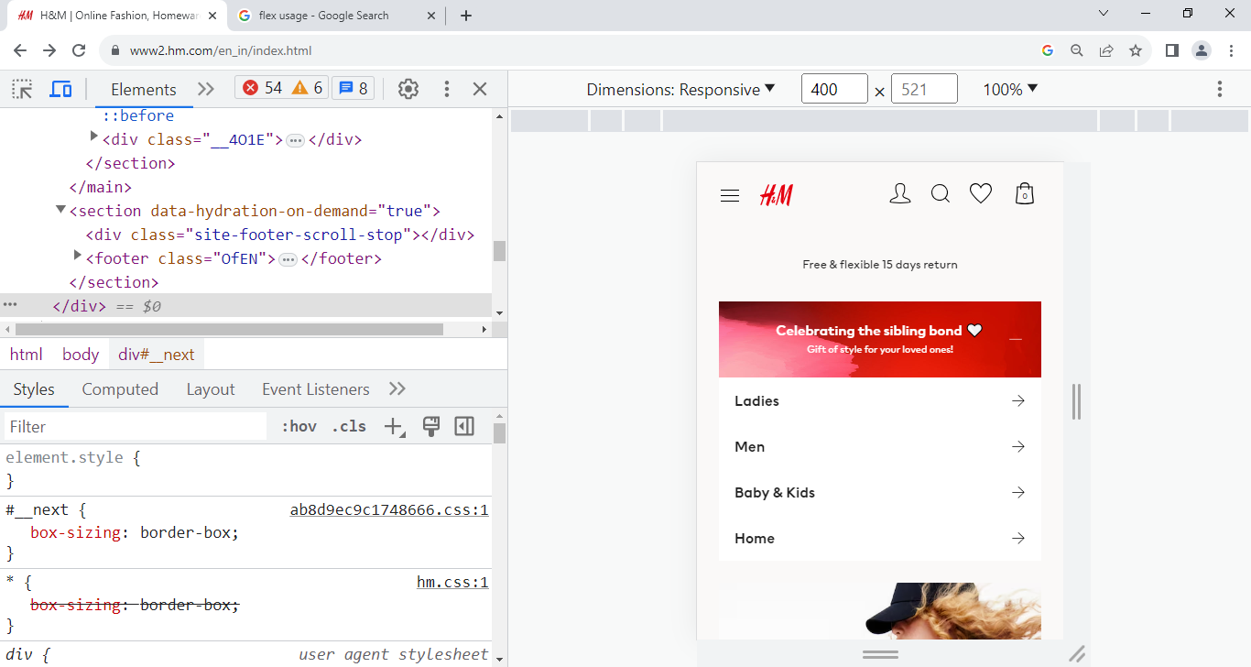
DIV TAG

Slide 7
FOOTER TAG

